Slide 1
Data Analytics (CMP330)
Dr. David Glass
School of Computing
dh.glass@ulster.ac.uk
Week 2 – Introduction to Programming with R
ulster.ac.uk

Slide 2
Week 2
Content
R Basics
R Matrices
R Data Frames
R Lists
R Factors
Data Input and Output with R
Useful functions in R
R programming structures

Slide 3
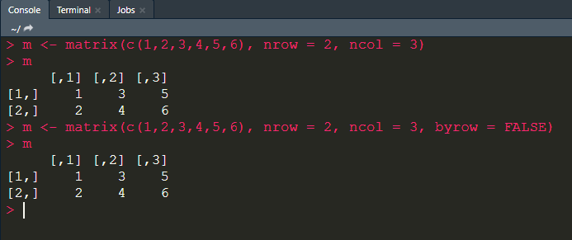
R Basics
R Matrices
Matrices are 2 dimensional vectors (or 2D arrays)
3 dimensional vectors are referred to as 3D arrays (no longer a matrix)
Column major order (what is this?)

Slide 4
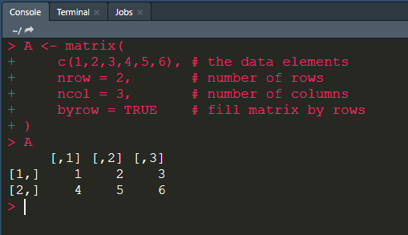
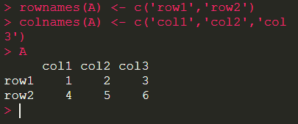

R Basics
R Matrices
Create a Matrix
$A=\left[\begin{matrix}1 & \begin{matrix}2 & 3\end{matrix} \\ 4 & \begin{matrix}5 & 6\end{matrix}\end{matrix}\right]$
Assign names to rows and columns of matrix

Slide 5
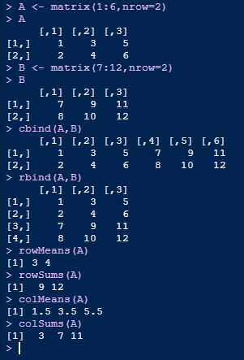
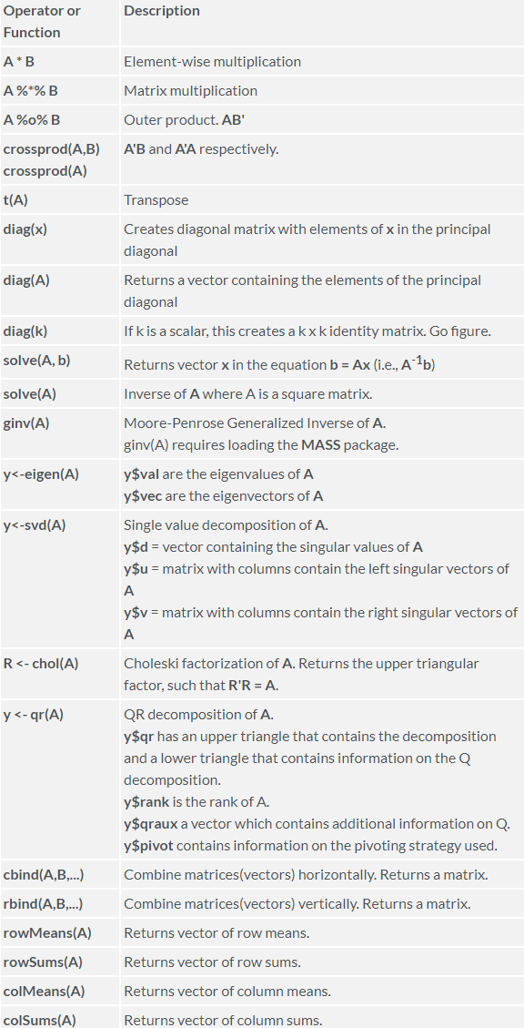
R Basics
R Matrices
Matrices operations
Matrices can be created by column-binding or row-binding

Slide 6
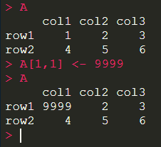
R Basics
R Matrices
Matrices – setting values
http://www.r-tutor.com/r-introduction/matrix

Slide 7
R Basics
R Matrices
Matrices arithmetic
https://www.statmethods.net/advstats/matrix.html

Slide 8
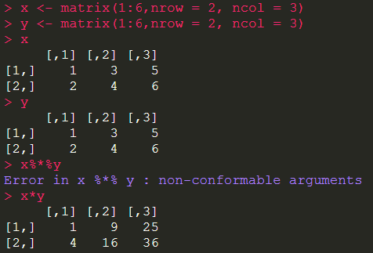
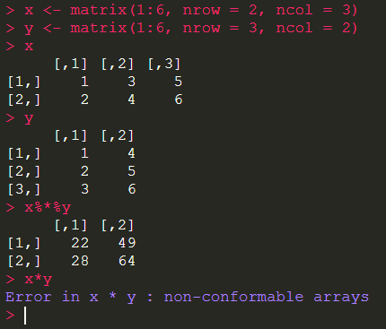
R Basics
R Matrices
Matrices arithmetic
Linear Algebra
https://www.statmethods.net/advstats/matrix.html

Slide 9
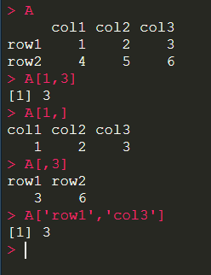
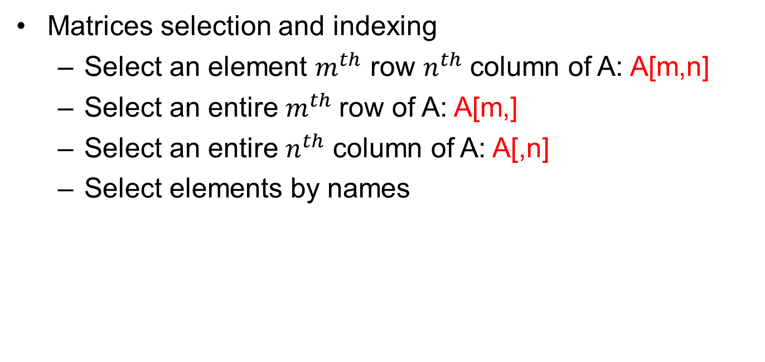
R Basics
R Matrices
Matrices selection and indexing
Select an element $m^{th}$ row $n^{th}$ column of A: A[m,n]
Select an entire $m^{th}$row of A: A[m,]
Select an entire $n^{th}$ column of A: A[,n]
Select elements by names
http://www.r-tutor.com/r-introduction/matrix

Slide 10
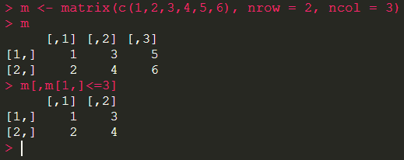
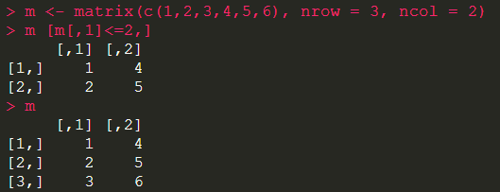
R Basics
R Matrices
Matrices subsetting

Slide 11
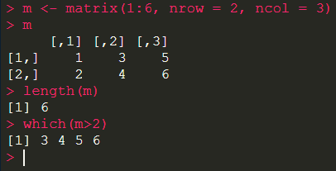
R Basics
R Matrices
Matrices subsetting
Remember matrices are just vectors – to prove it:

Slide 12
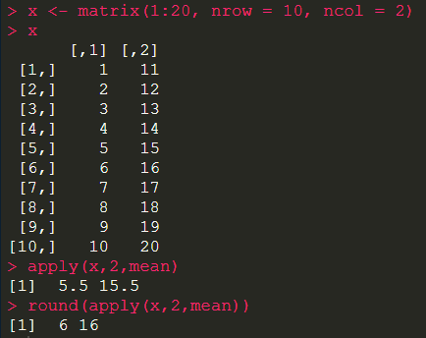
R Basics
Matrix function in R - Apply() Function
One of the most used functions in R:
apply(x, MARGIN, FUN,…)
- x is an array, including a matrix
- MARGIN: 1 for rows, 2 for columns
- FUN: the function to be applied

Slide 13
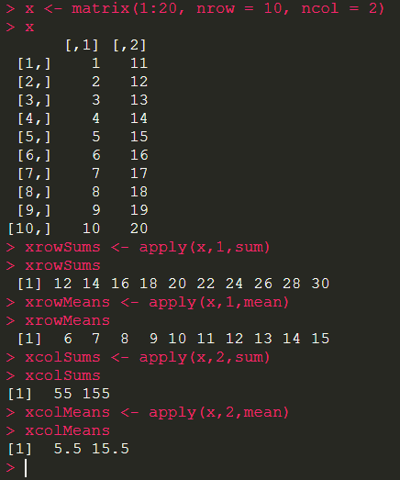
R Basics
Matrix function in R - Apply() Function
apply(x, MARGIN, FUN,…)

Slide 14
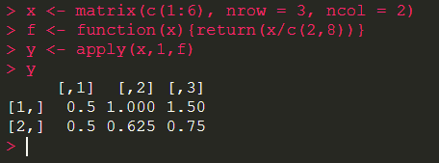
R Basics
Matrix function in R - Apply() Function
apply(x, MARGIN, FUN,…)

Slide 15
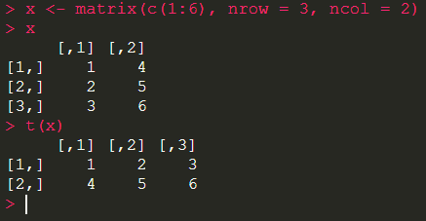
R Basics
Other Matrix functions
Transpose
t()

Slide 16
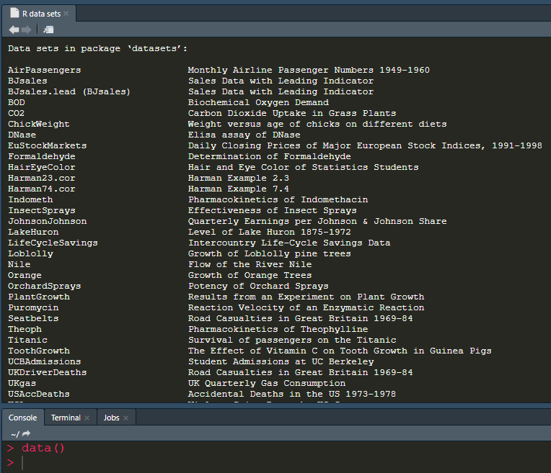
R Basics
R Data frames (core in R)
R’s built-in data sets
data()

Slide 17
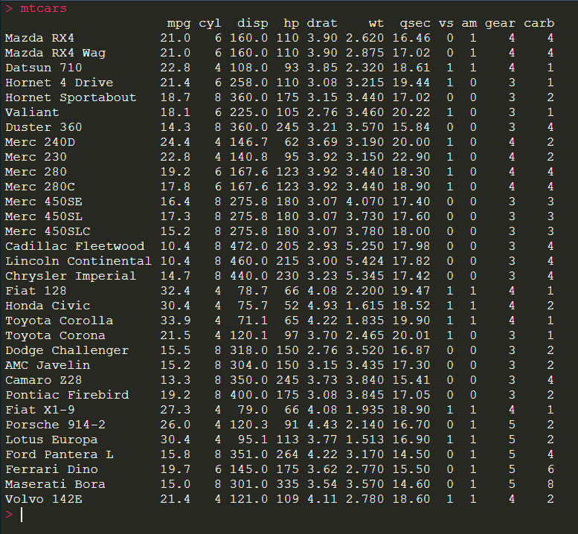
R Basics
R Data frames
R’s built-in data sets

Slide 18

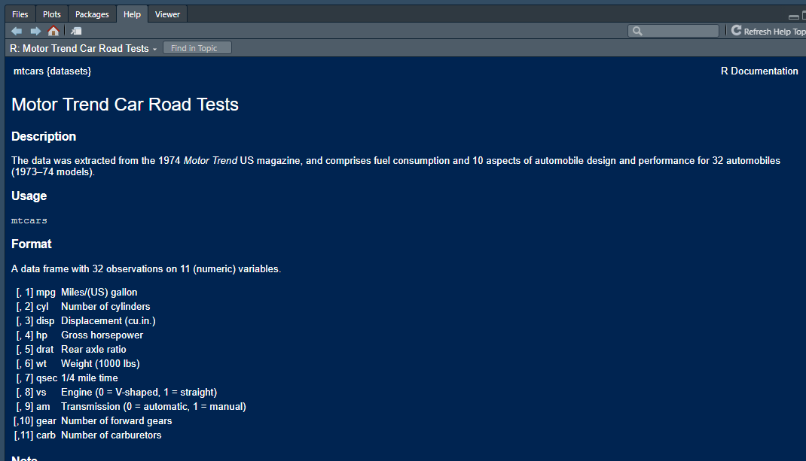
R Basics
R Data frames
R’s built-in data sets

Slide 19
R Basics
R Data frames
Stores tabular data
Every list element in the data frame must have the same length
Different from matrices as data frames can store different classes of elements just like lists
Can be described as a list of equal length vectors
Basically a 2-dimensional list (a list of lists)
Data frames are created or imported using
data.frame(), read.table() or read.csv()
A data frame be converted to a matrix
data.matrix(data frame)

Slide 20
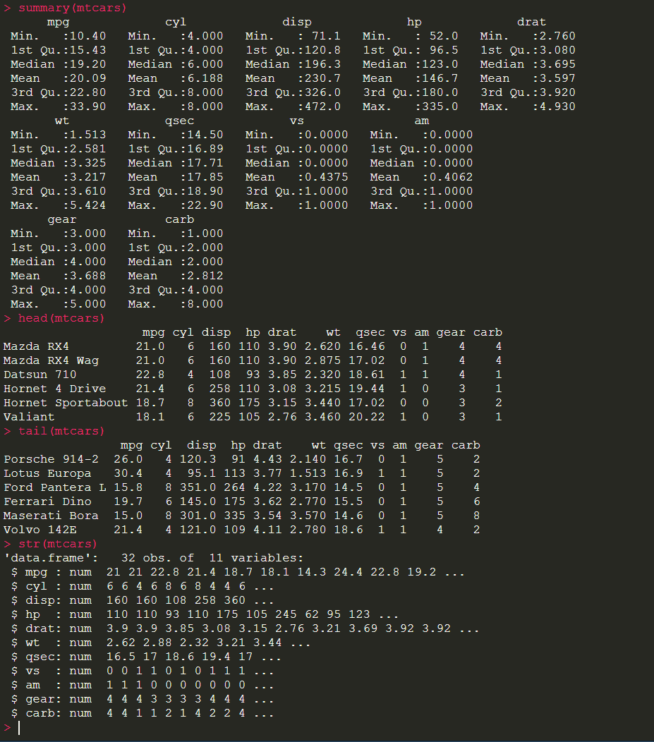
R Basics
R Data frames
Some useful functions to do initial analysis
head()
tail()
str()
summary()

Slide 21
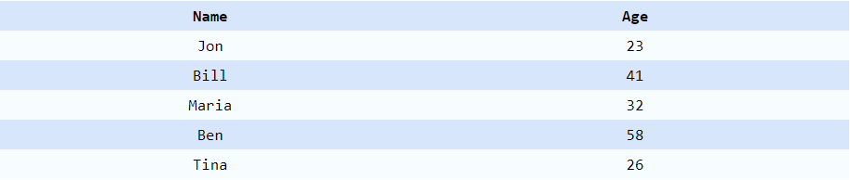
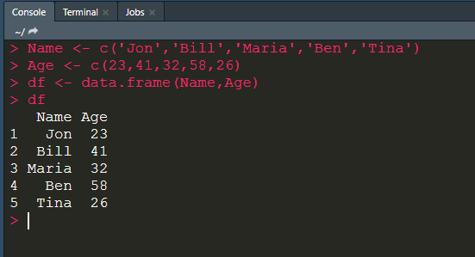
R Basics
R Data frames
Create a data frame from vectors

Slide 22
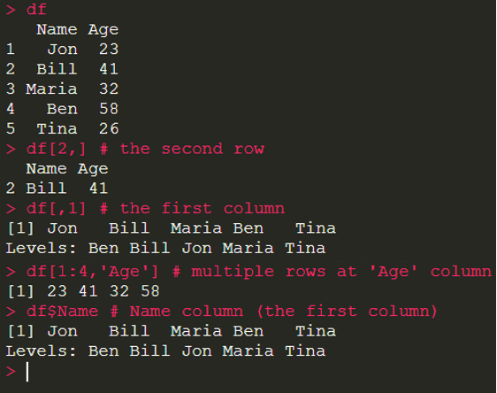
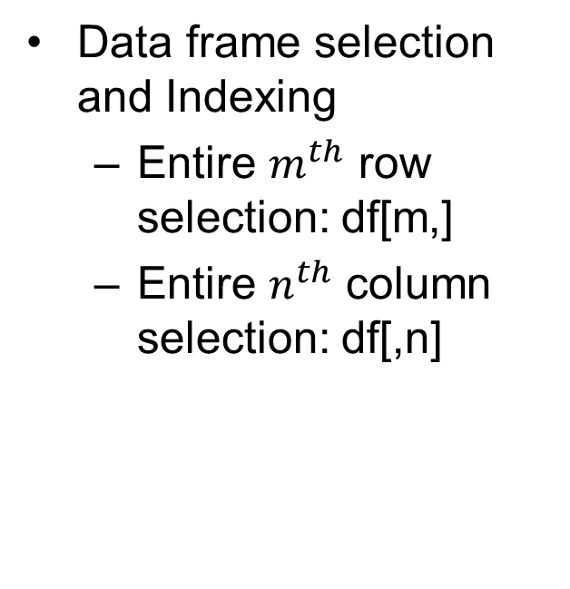
R Basics
R Data frames (core in R)
Data frame selection and Indexing
Entire $m^{th}$ row selection: df[m,]
Entire $n^{th}$ column selection: df[,n]

Slide 23
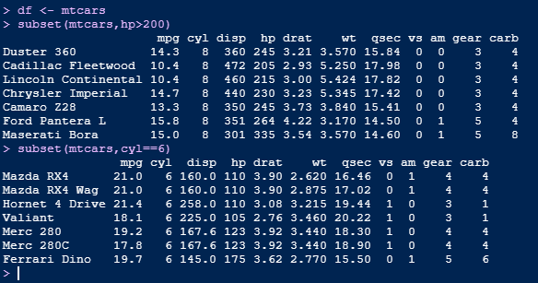
R Basics
R Data frames (core in R)
Data frame selection using subset() function

Slide 24
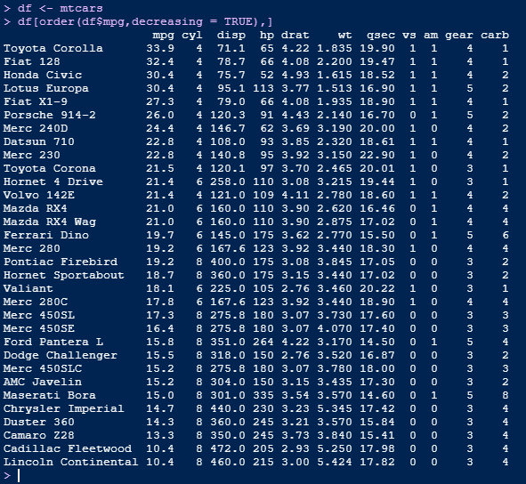
R Basics
R Data frames (core in R)
Ordering a data frame – order() function

Slide 25
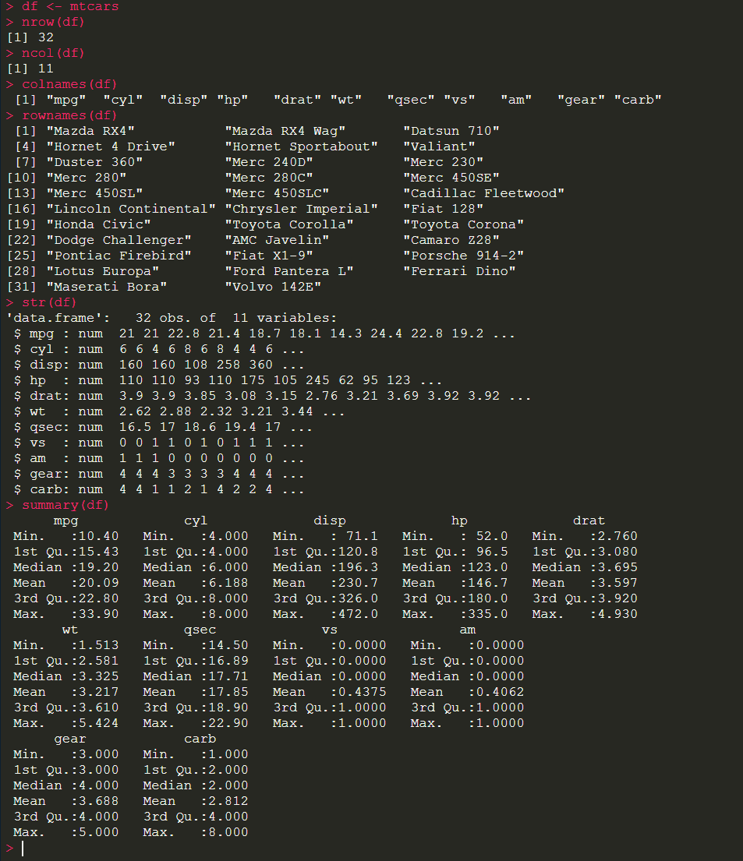
R Basics
R Data frames
Data frame operations
Getting information of a data frame
nrow()
ncol()
colnames()
rownames()
str()
summary()

Slide 26
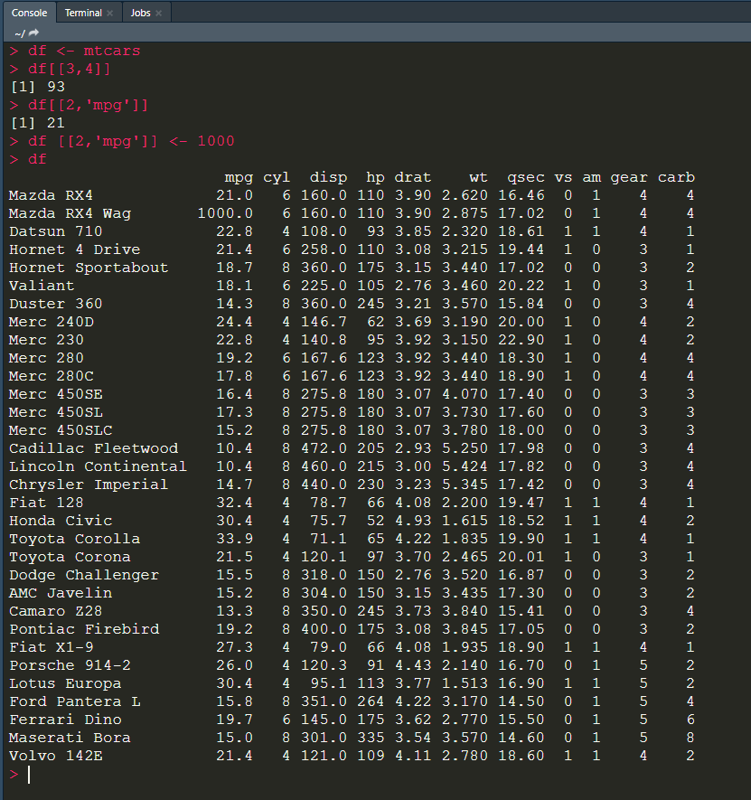

R Basics
R Data frames
Data frame operations
Reference cells
$m^{th}$ row $n^{th}$ column
df[[m,n]]

Slide 27
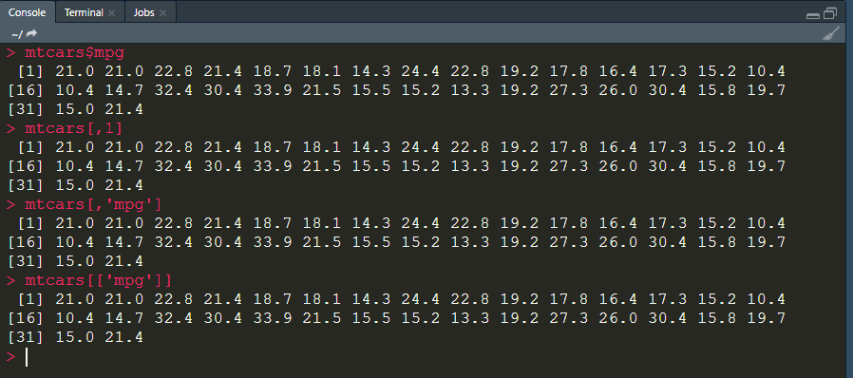
R Basics
R Data frames
Data frame operations
Four ways of getting a column value

Slide 28
R Basics
R Data frames
Merge different Data Frames
merge()
merge(d1, d2, by.x=“fullnames”, by.y=“names”)
help(‘merge’)
Inner join, Outer join, left (outer) join, right (outer) join

Slide 29
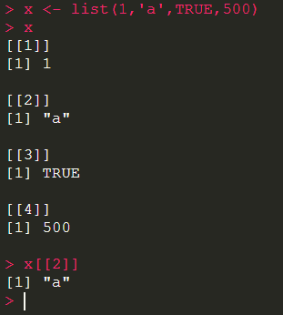
R Basics
R Lists
A list is a vector that can contain elements of different modes/classes/data types
Note the use of double brackets!

Slide 30
R Basics
R Lists
A list is a vector that can contain elements of different modes/classes/data types
Note the use of double brackets!

Slide 31
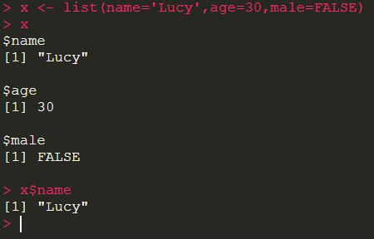
R Basics
R Lists
Key value pairs

Slide 32
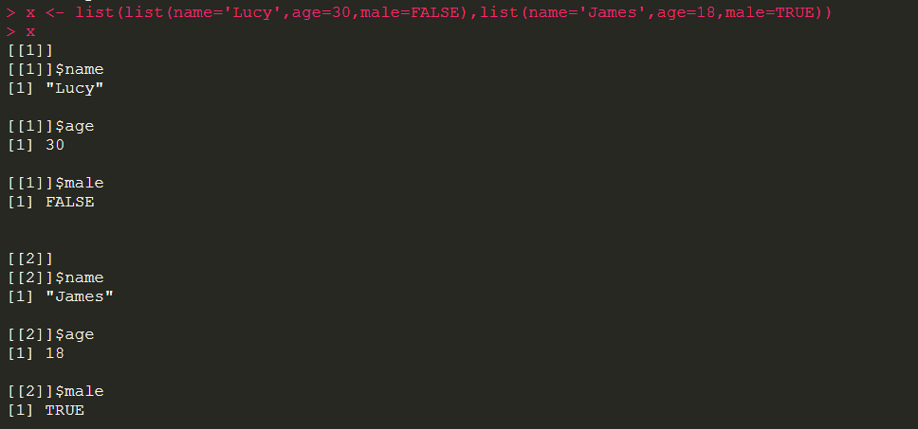
R Basics
R Lists
Lists within a list

Slide 33
R Basics
R Factors
Factors represent nominal/categorical data.
“Male” and “Female”
“Labour” and “Tory”
“GCSE” and “A-level” and “BSc”
“Cat” and “Dog”
“Low” and “Medium” and “High”

Slide 34
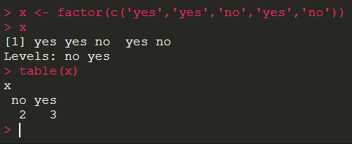
R Basics
R Factors
Create a factor using factor()
table() function is great for counting
Notes:
Table function is great for counting

Slide 35
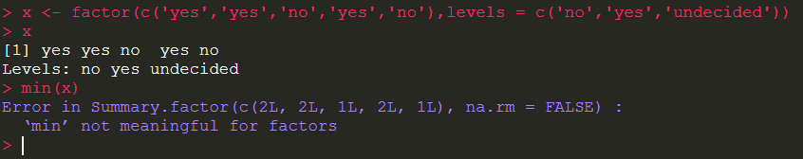
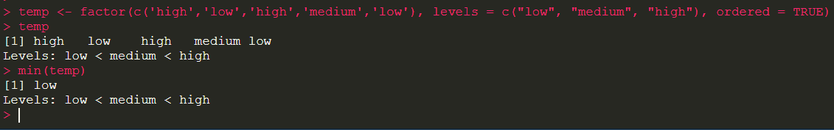
R Basics
R Factors
Unordered factors
Ordered factors

Slide 36
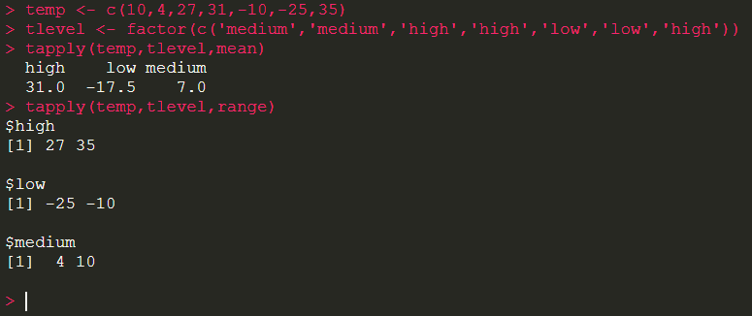
R Basics
R Factors
tapply() function

Slide 37
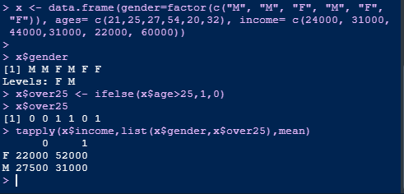
R Basics
R Factors
Contingency table

Slide 38
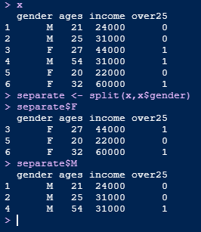
R Basics
R Factors
split() function

Slide 39
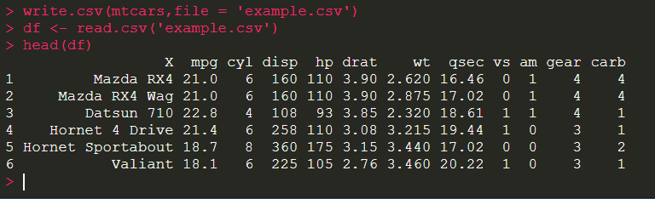
Data Input and Output with R
CSV files with R
read & write a CSV file

Slide 40
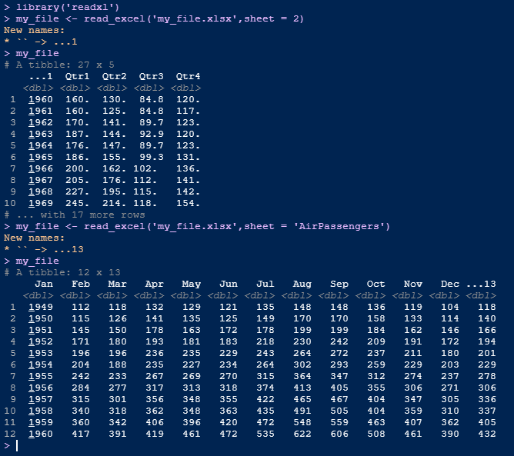
Data Input and Output with R
Excel files with R
Using readxl package
install.packages(“readxl")
Specify sheet with a number or name

Slide 41
Data Input and Output with R
SQL with R
Access a database from R
Run SQL queries in R using RSQLite and dplyr
Useful resources:
https://carpentries-incubator.github.io/R-archaeology-lesson/05-r-and-databases.html
https://www.r-bloggers.com/2021/01/learn-how-to-write-sql-from-r/

Slide 42
Data Input and Output with R
Web Scraping with R
Easy web scraping with R – rvest
Getting twitter data using R
Useful resources:
https://www.rstudio.com/blog/rvest-easy-web-scraping-with-r/
https://developer.twitter.com/en/docs/tutorials/getting-started-with-r-and-v2-of-the-twitter-api

Slide 43
Handling Missing values
Missing values: NA and NAN
Missing values are denoted by NA or NaN
is.na(x) is used to test for NA
is.nan(x) is used to test for NaN
Data Cleansing scenario
x[is.na(x) | is.nan(x) ] <- 0
x[is.na(x) | is.nan(x) ] <- mean(x, na.rm=TRUE)
'NaN' means not a number. Impossible values (e.g., dividing by zero) are represented by the symbol NaN (not a number).

Slide 44
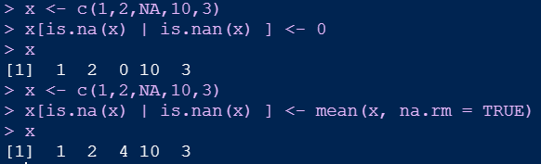
Handling Missing values
Handling NA and NAN
Handling NA and NAN
replace the missing values with 0 or mean

Slide 45
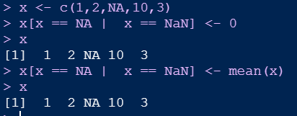
Handling Missing values
Missing values: NA and NAN
Note: You can't use
x[x == NA | x == NaN] <- 0
x[x == NA | x == NaN] <- mean(x)
Detecting NAs - You can't find missing values by looking at x == NA.
Like most other functions, the == operator returns NA when either argument is NA.
The is.na() function will find missing values for you

Slide 46
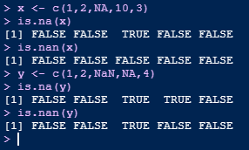
Handling Missing values
NA and NAN functions
Note: NaN values are also an NA but the opposite is not true

Slide 47
R Packages
install.packages("psych")
library(psych)
describe(mtcars)

Slide 48
R programming structures
If statements
If the else statements
For and while loops
Custom functions

Slide 49
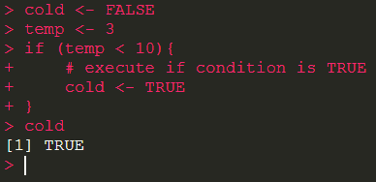
R programming structures
If statements
if(condition) expression

Slide 50
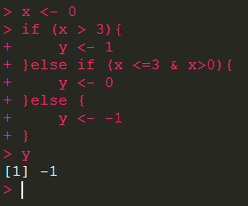
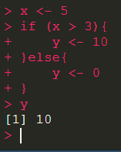
R programming structures
If then else statements

Slide 51
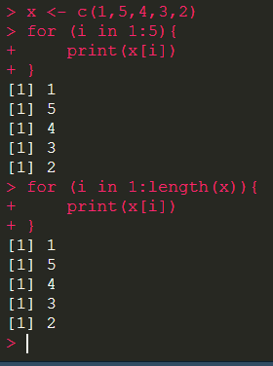
R programming structures
For loops

Slide 52

R programming structures
For loops
Nested For loops

Slide 53

R programming structures
While loop

Slide 54
R programming structures
Repeat and Break
repeat {
if(<condition>) {
break
} else {
#do some calculations
}
}

Slide 55
R programming structures
Next
for(i in 1:50) {
if(i <= 10) {
## Skip the first 10 iterations
next
}
# Do some calculations
}

Slide 56
R programming structures
Custom functions
f <- function(<arguments>) {
## Do something interesting
}

Slide 57

R programming structures
Custom functions

Slide 58
R programming structures
Functions
Not all arguments have to be used
You can pass in arguments in the right order or an arbitrary order providing you specify the argument names
args(sd)
sd(mydata, na.rm=TRUE)
sd(na.rm=TRUE, x = mydata)

Slide 59
Some tips
Variable Scope
Global variables
Local variables
y <-2
f <- function(a, b) {
y <- a*b
y
}
f(2,3)

Slide 60
Some tips
Scope order when using the console
To retrieve a value of an R object:
R searches the global environment
Then searches namespaces
search()

Slide 61

Some tips
Scope order when using the console

Slide 62
Some tips
Lexical Scoping
Lexical scoping in R means that
the values of free variables are searched for in the environment in which the function was defined

Slide 63
Some tips
Lexical Scoping
Lexical scoping in R means that
the values of free variables are searched for in the environment in which the function was defined

Slide 64
Some tips
Lexical Scoping
Search through parent environments until it reaches the top level
Then it will check the global environment

Slide 65

Some tips
Lexical vs. Dynamic Scoping
y <- 10
f <- function(x) {
y <- 2
y^2 + g(x)
}
g <- function(x) {
x*y
}
f(3)
Dynamic – y is taken from the environment where the g function is called.
Lexical – y is taken from the environment where the g function is defined

Slide 66
Some tips
Helpful Functions
Help() or ?
Example()
Class()
Head()
Str()
Summary()

Slide 67
Things to Check out
R Libraries
Tidyverse
Caret package
https://support.rstudio.com/hc/en-us/articles/201057987-Quick-list-of-useful-R-packages
R Mark down files
String manipulation
SQL connections
High performance computing

